Slide 1
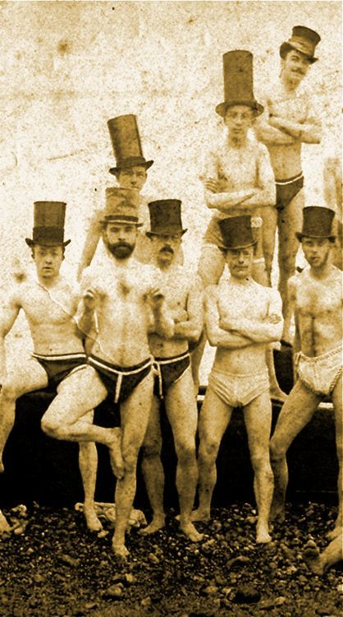
Becoming Bros: The History of Fraternity Masculinity
The Last Lecture Series
9.25.19
Mir Yarfitz
yarfitmh@wfu.edu
Department of History
Tribble B-114

Slide 2
Definitions
Racist: One who is supporting a racist policy through their actions or inaction or expressing a racist idea.
Antiracist: One who is supporting an antiracist policy through their actions or expressing an antiracist idea.
There is no such thing as “not racist.”
Kendi, Ibram X. How to Be an Antiracist. New York: One World, 2019.

Slide 3
What is masculinity?
What does it mean to be masculine, a “real man,” a “good man,” a “bro,” etc.?
What is not masculine? How does it look to fail? What are the punishments?

Slide 4
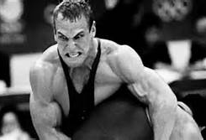
Some meanings of manliness
(time, place, and culturally specific):
Decisive/angry
Sexual drive
Financial provider
Athletic
Solitary
Not a boy
Not a woman
Not gay

Slide 5
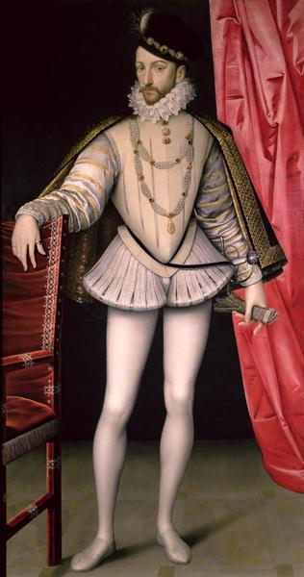
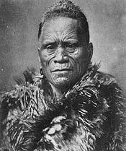
Other Models of Masculinity
Father / family-oriented
Adventurer / wanderer
Sexual domination/penetration (of any gender)
Calm / deliberate
Peacocking
Tāwhiao, the second Māori King (1860–1894)
Charles IX, King of France (1550-1574)

Slide 6
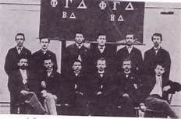
Masculine ideals in white US fraternities
Fraternities have usually been seen as reflecting the dominant norm of masculinity, the standard by which all men are measured
Some men considered more masculine than others; the most masculine are rewarded
Most American men are aware of these standards and try to meet them, but can’t because zero sum -- this creates anxiety, overcompensation

Slide 7
Mid-19th century
White US college fraternities from 1825 on; mostly in all-male universities
Inherently exclusionary; in opposition to poorer, more rule-following classmates studying to join the ministry
Good academic standing valued, but not working too hard for it
Refined social graces of the era – manners, public speaking, performance – Greek, Latin, drama, poetry
Camaraderie, brotherhood – social bonds would help in future business careers; loyalty to brothers in opposition to other groups – competition would be done together, not as individuals

Slide 8
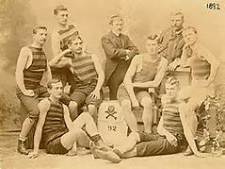
Late 19th to early 20th century
Shift from academic ideals to sports
More immigrants came to college – led to more exclusion, whites and Protestants only
Good manners and social training
Some contradiction between this and rise of drinking culture (to excess) – also smoking, gambling, dancing, theater, partying at away games
Goal: gentleman in public, rowdy in private

Slide 9
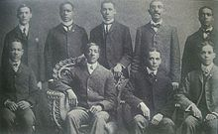
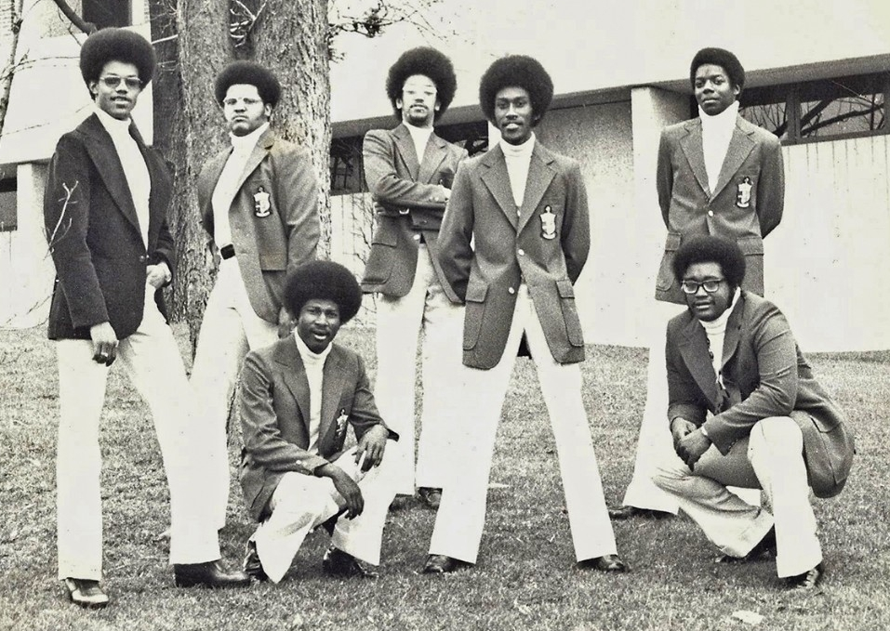
Black Greek-Letter Organizations
9 BGLOs under the National Pan-Hellenic Council (5 fraternities, 4 sororities) – “The Divine Nine”
Early 20th c. created both at predominantly white colleges (PWIs) and black institutions (HBCUs)
Jim Crow era – black students excluded from social, literary, and athletic organizations, thus started their own
Alpha Kappa Nu, 1903-1905
Kappa Alpha Psi, mid1970s, U. Cin.

Slide 10
20th century
Addition of female students to college campuses changed fraternity culture
Manhood became the opposite of womanhood, no longer of boyhood
Development of concept of homosexuality meant all-male groups had to prove they weren’t gay
Thus new priority on sexual behavior – first with working class women and prostitutes, then later with female classmates – but not as equals, to preserve and highlight the distinction between men and women
New standard: conservative, rule-abiding men by day, and hard-drinking womanizers by night

Slide 11
So what? Now what?

Slide 12
https://www.kappaalphaorder.org/chapters/wake-forest-university/
People Make Institutions;
People Change Institutions

Slide 13
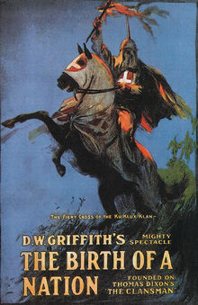

Slide 14
Campus Resources
Non-Confidential
Title IX Office
Campus Police, W-S Police
Peter Rives – Alcohol and Substance Abuse Prevention
Faculty and staff are only required to report if you give details of sexual misconduct involving you or named individuals – we will not trick you into this, and can help you navigate getting support
Confidential
SAFE Office
24/7 Confidential HelpLine: 336.758.5285
University Counseling Center
Office of the Chaplain
Student Health Service
Collegiate Recovery Community
-Recovery Lounge

Slide 15
DeSantis, Alan D., and Alan D. D. DeSantis. Inside Greek U.: Fraternities, Sororities, and the Pursuit of Pleasure, Power, and Prestige. Lexington: University Press of Kentucky, 2007.
DiAngelo, Robin. White Fragility: Why It’s So Hard for White People to Talk About Racism. Boston: Beacon Press, 2018.
Flanagan, Caitlin. “The Dark Power of Fraternities.” The Atlantic, March 2014.
Hughey, Matthew W., Gregory S. Parks, and Theda Skocpol. Black Greek-Letter Organizations 2.0: New Directions in the Study of African American Fraternities and Sororities. Jackson: University Press of Mississippi, 2011.
Hunter, Joanna S., and Matthew W. Hughey. “‘It’s Not Written on Their Skin like It Is Ours’: Greek Letter Organizations in the Age of the Multicultural Imperative.” Ethnicities 13, no. 5 (2013): 519–43.
Kendi, Ibram X. How to Be an Antiracist. New York: One World, 2019.
Syrett, Nicholas L. Company He Keeps: A History of White College Fraternities. Chapel Hill: The University of North Carolina Press, 2009.

